Slide 1

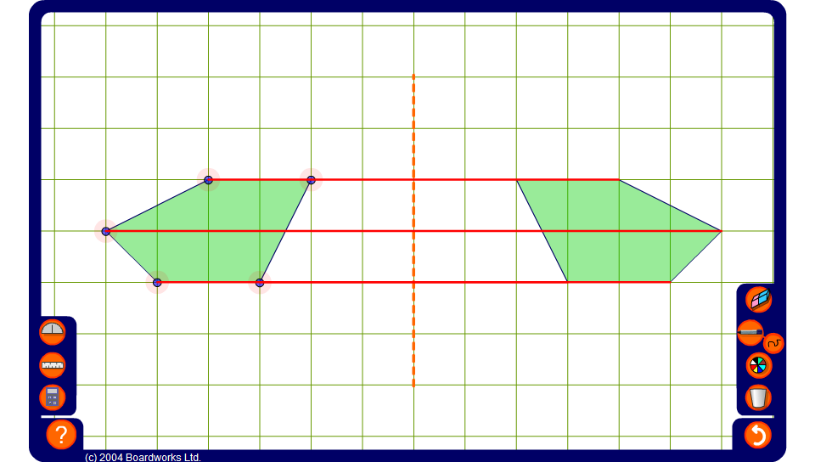


Reflecting shapes
Notes:
Use this activity to dynamically prove the result on the previous slide, regardless of the shape or the position of the mirror line.

